Slide 1
Random Forest

Slide 2
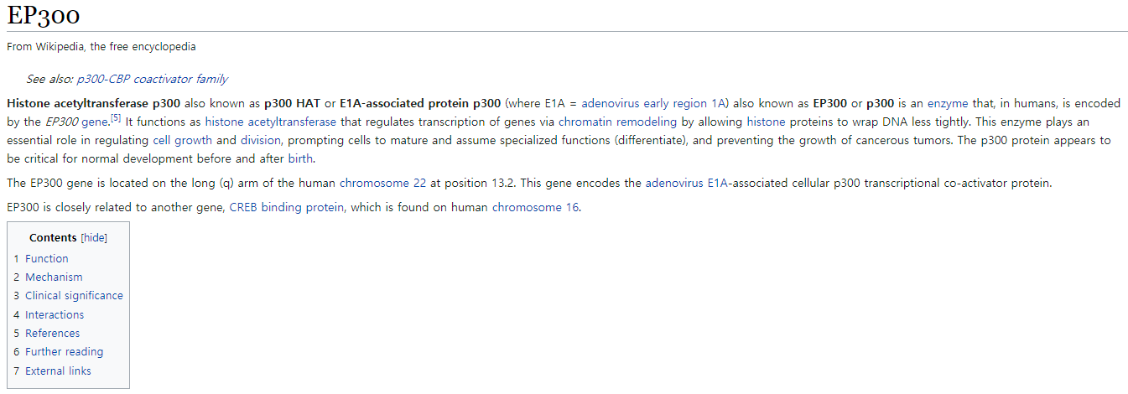

Slide 3
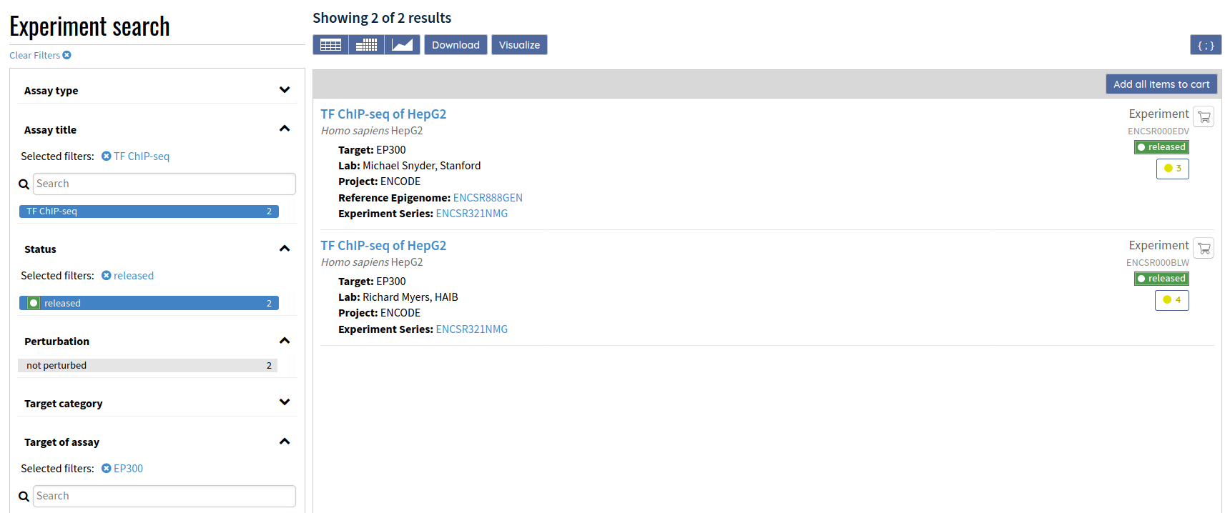
p300 ChIP-seq data로 active enhancer (1) 생성

Slide 4
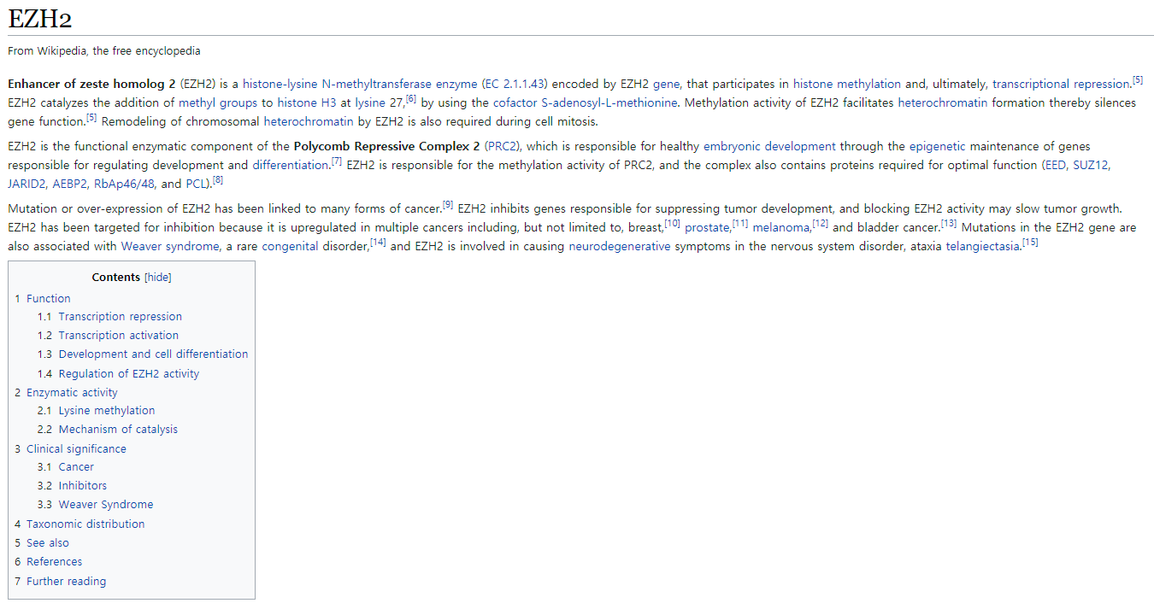

Slide 5
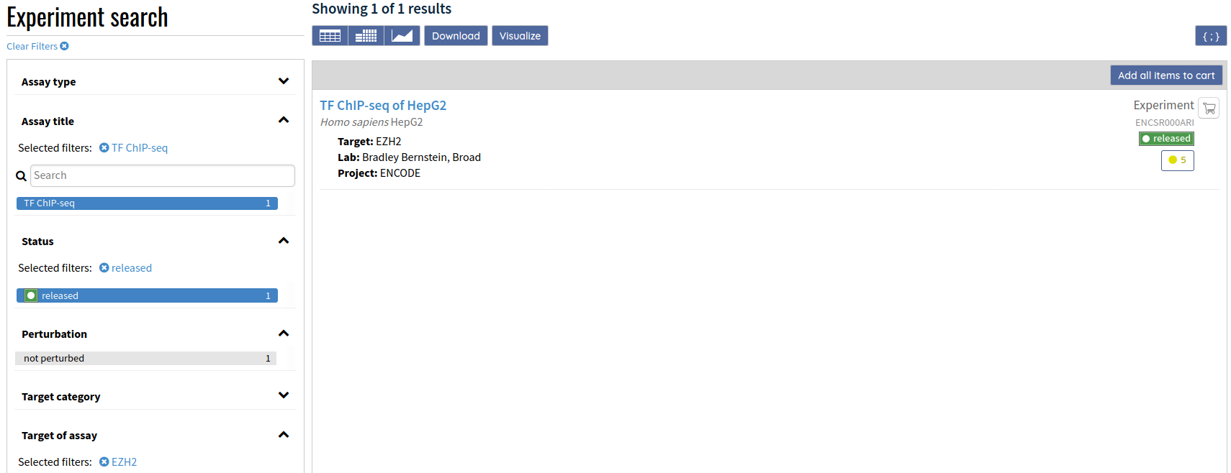
EZH2 ChIP-seq data로 repressed enhancer (0) 생성

Slide 6
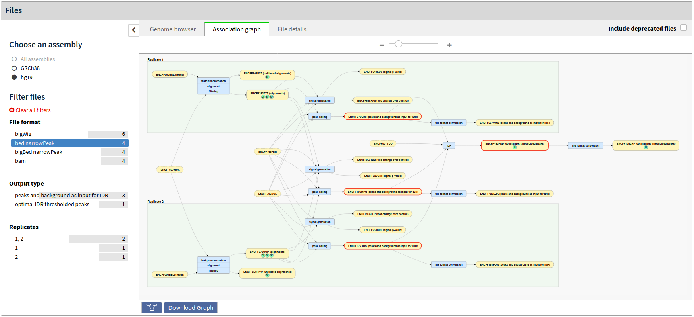
①
②
③

Slide 7
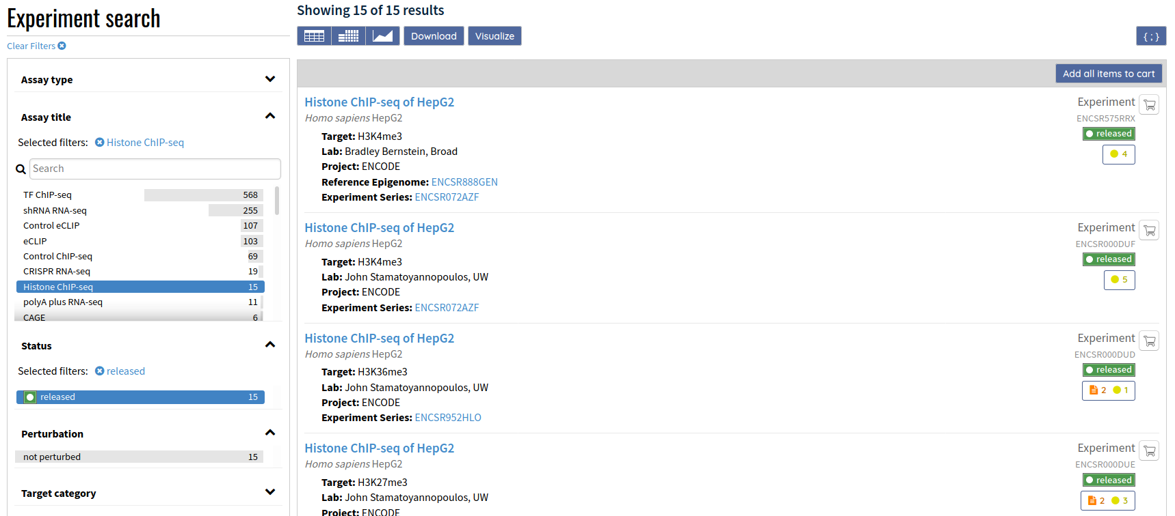
histone ChIP-seq data

Slide 8
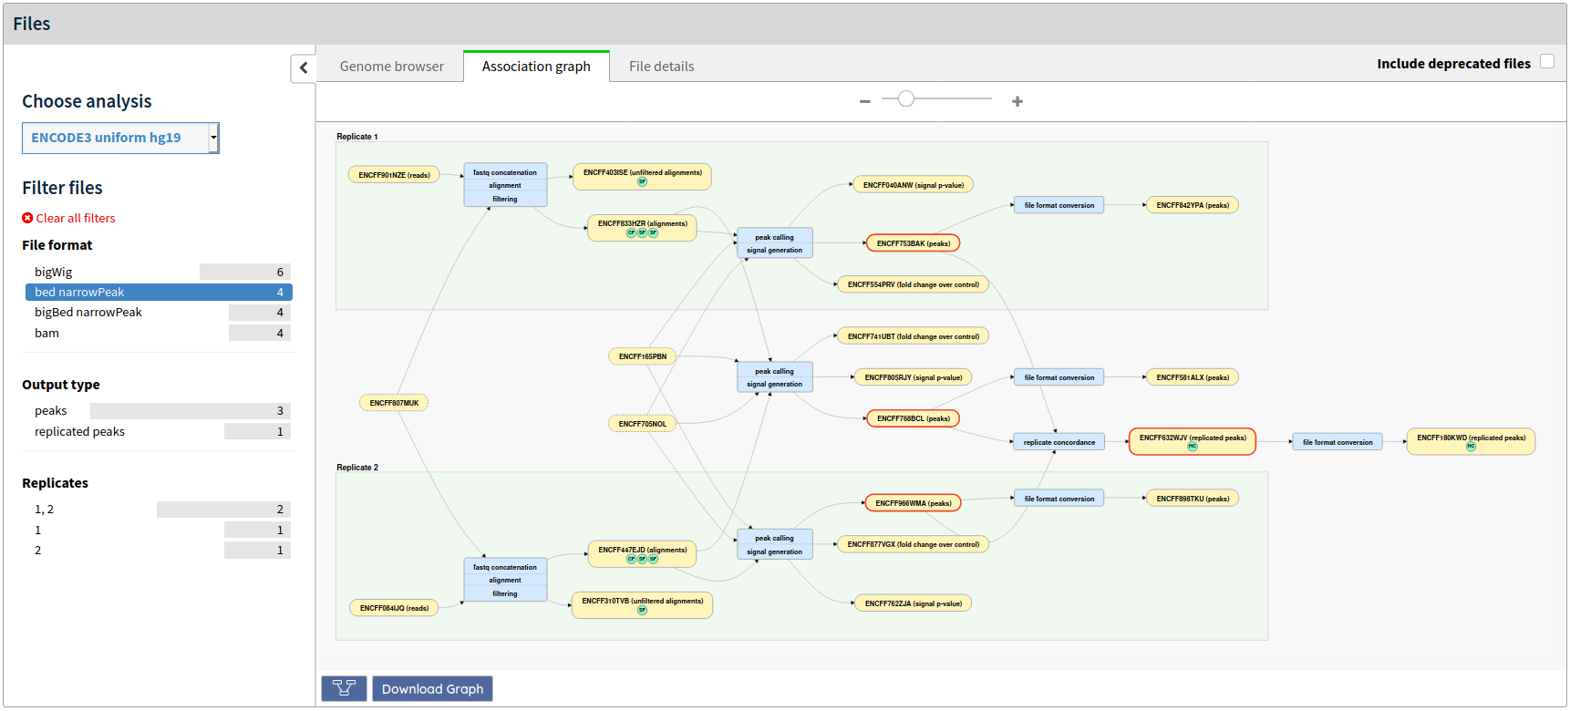
histone ChIP-seq data
①
②
③

Slide 9
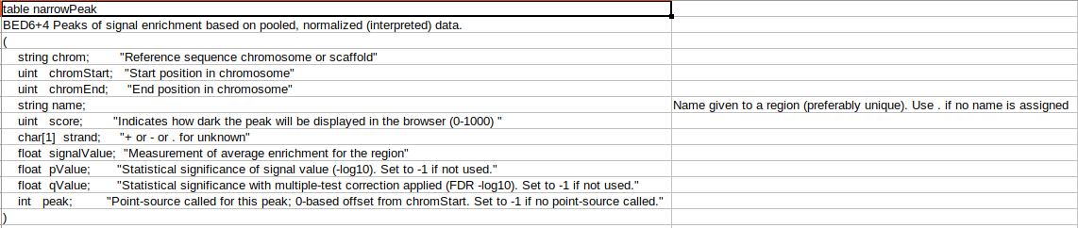
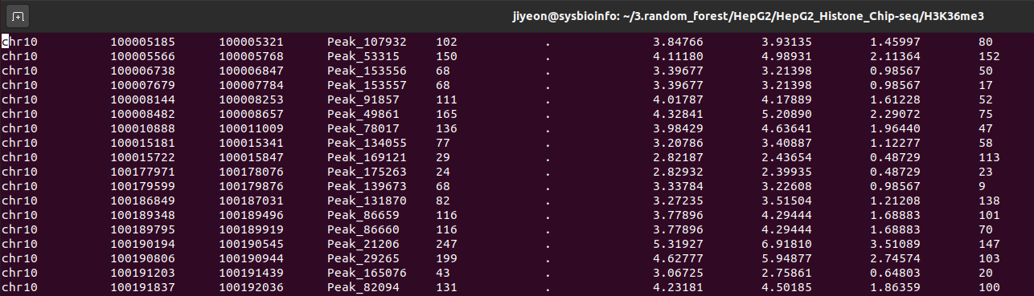

Slide 10
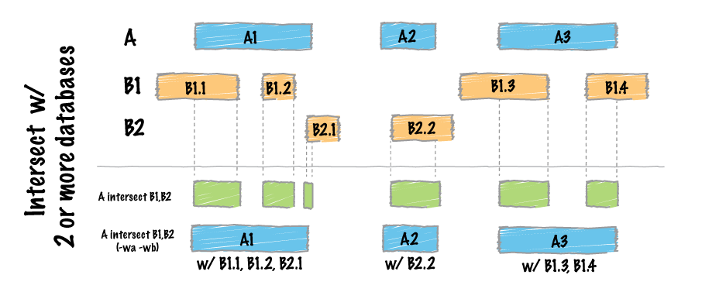
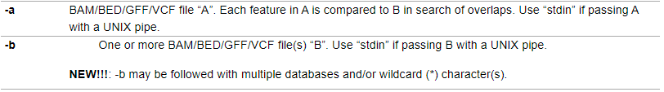

Slide 11
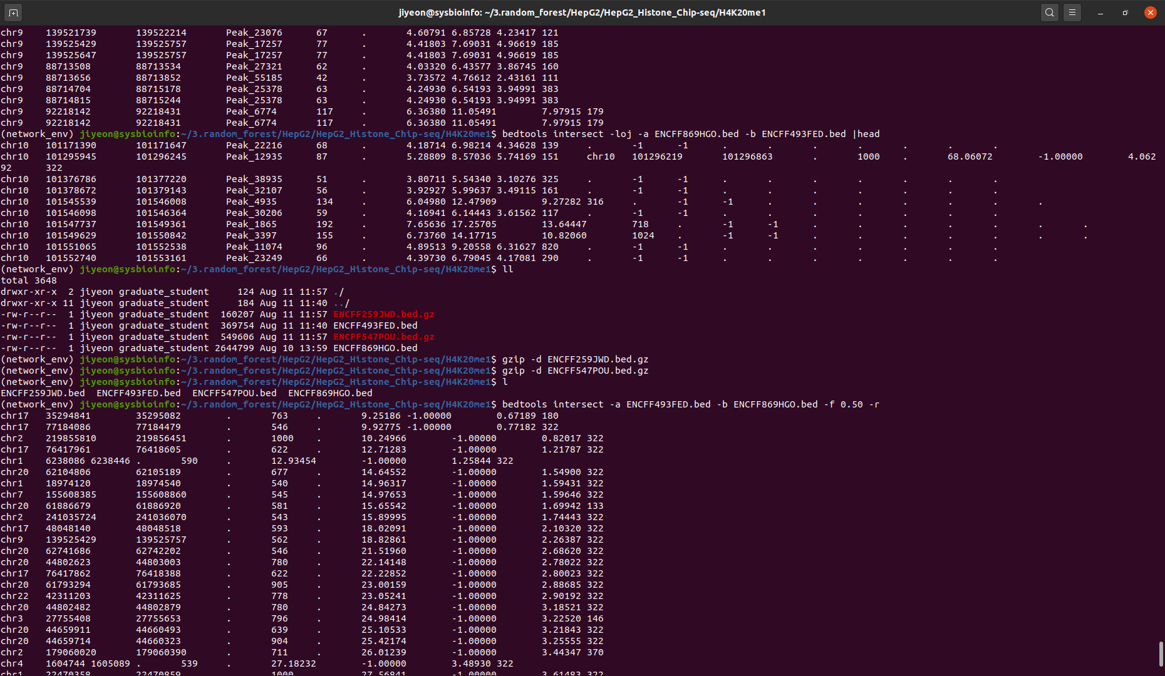
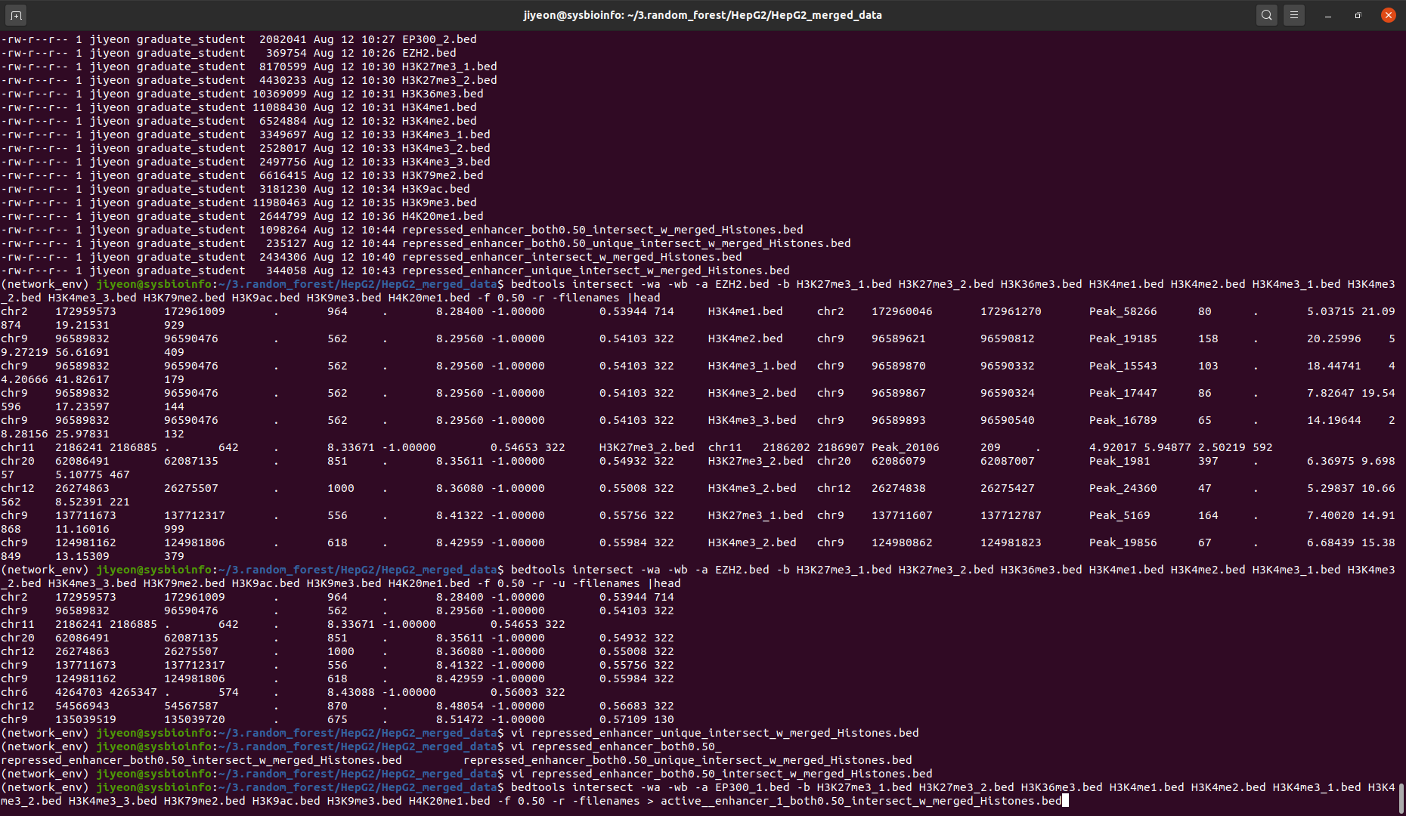
bedtools intersect –wa –wb –a EP300_1.bed –b H3K27me3_1.bed H2K27me3_2.bed … -f 0.50 –r –filenames > 파일명

Slide 12
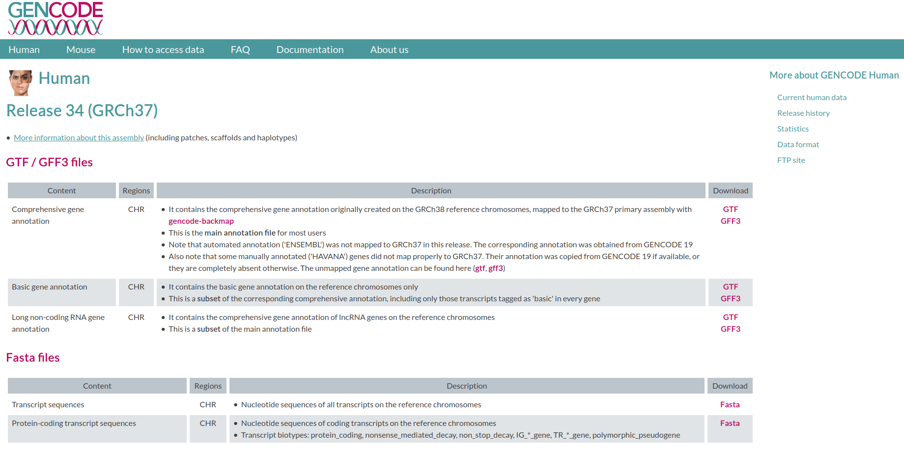
http://www.incodom.kr/GFF_and_GTF

Slide 13
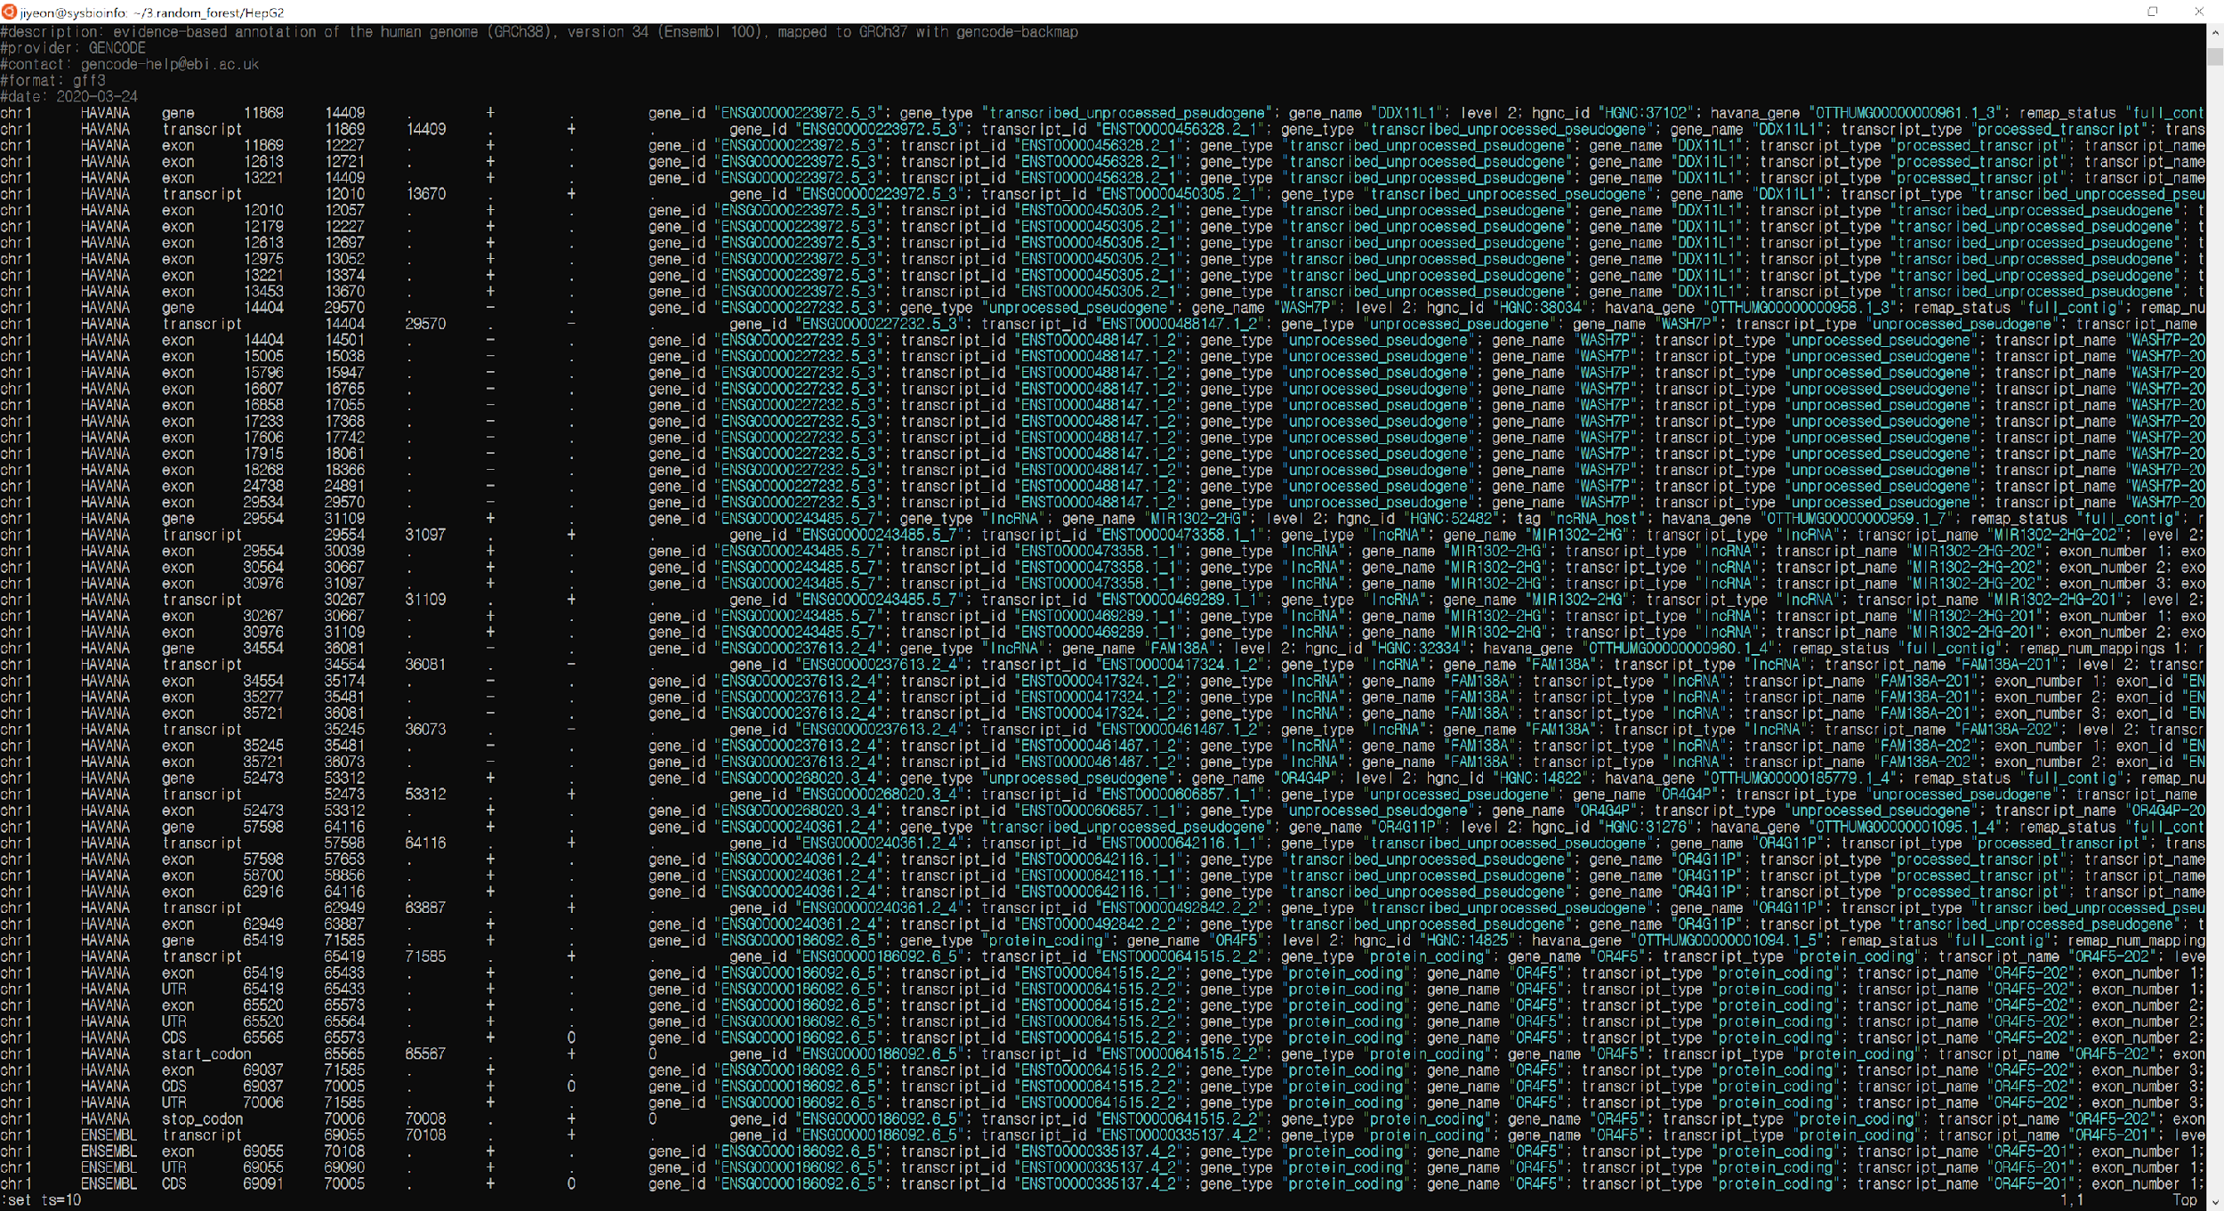

Slide 14
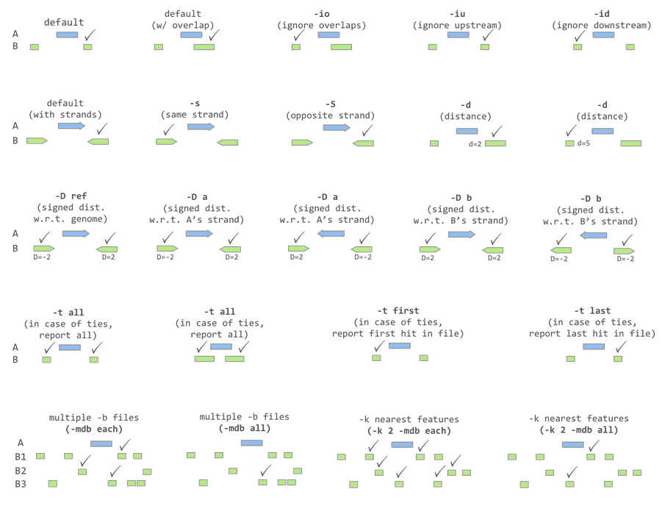

Slide 15
Pos | H3K27ac | H3K27me3 | H3K36me3 | H3K4me3 | H3K9me3 | Enhancer
chr1:100296889 | 0 | 1 | 1 | 0.5 | 1 | 0
chr1:106807167 | 9 | 12 | 17 | 4.5 | 7 | 1
chr1:107671304 | 8 | 18 | 7 | 12.5 | 4 | 1
chr1:108287215 | 11 | 3 | 3 | 1 | 2 | 0
chr1:108482056 | 13 | 7 | 3 | 0.5 | 5 | 1
chr1:108661771 | 17 | 3 | 3 | 2 | 3 | 1
chr1:108744897 | 15 | 8 | 6 | 7.5 | 8 | 0

